Slide 1
Public Benefits Training
Jacob M. Eden, Senior Staff Attorney
eden@lawprojectpa.org
AIDS Law Project of PA

Slide 2
Agenda
Day 1 – Medical Assistance
MAGI
Healthy Horizons
MAWD
And SPBP
Day 2 – Social Security
And Buy-in and Dual Eligibles

Slide 3
Preliminary Question 1
Is asymptomatic HIV infection a disability?
Yes
No
Who’s asking?

Slide 4
Preliminary Question 2
Joe earns $1,285 per month at his job.
Joe’s monthly income is?
$1,285
$600
Who’s asking?

Slide 5
Answer
The Government falls back on what it describes as the “common parlance” meaning of the phrase “exceeds authorized access.” According to the Government, any ordinary speaker of the English language would think that Van Buren exceeded his authorized access to the law enforcement database when he obtained license-plate information for personal purposes. If the phrase “exceeds authorized access” were all we had to go on, the Government and the dissent might have a point. But both breeze by the Computer Fraud and Abuse Act’s explicit definition of the phrase “exceeds authorized access.”
When a statute includes an explicit definition of a term, we must follow that definition, even if it varies from a term’s ordinary meaning. So the relevant question is not whether Van Buren exceeded his authorized access but whether he exceeded his authorized access as the CFAA defines that phrase.
- Van Buren v. United States (cites, quotations removed)

Slide 6
Answers
Both Disability and Income have different definitions or meanings in different public benefits programs.
You must know each programs rules to figure out whether a person qualifies.

Slide 7
Overview of DHS
Department of Human Services
(formerly, Department of Public Welfare)
DHS administers and oversees benefits:
Food Stamps (SNAP)
Temporary Assistance for Needy Families (TANF)
General Assistance
Medicaid (in all its forms)
Low-income Home Energy Assistance Program (LIHEAP)
Organized into County Assistance Offices (CAOs)
Place where most client interactions occur
Apply, appeal, submit documents (always get receipt)
Chain of Command: Case Worker → Supervisor → Assistant District Administrator → District Administrator
Assistant Executive Director → Executive Director
CAOs in Philadelphia have a different chain: CW → Spv → ADA → DA

Slide 8
Appeal Deadlines
To Keep Benefits Coming:
APPEAL WITHIN 15 DAYS
(The date of the deadline is usually included within the notice –this assumes notice received 5 days after notice date. If for some reason notice did not arrive until later, make sure to tell the CAO when notice received)
Deadlines:
For TANF, MA, GA: 30 days
For SNAP/Food stamps: 90 days

Slide 9
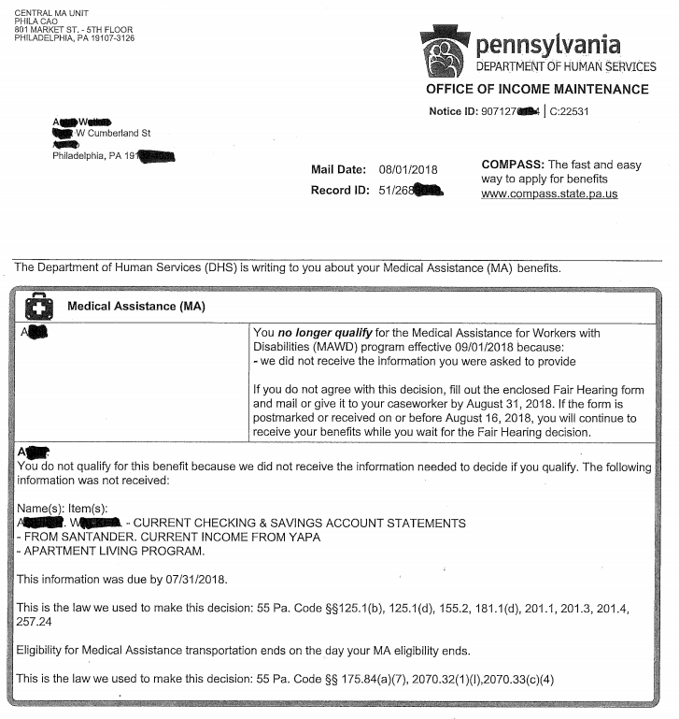
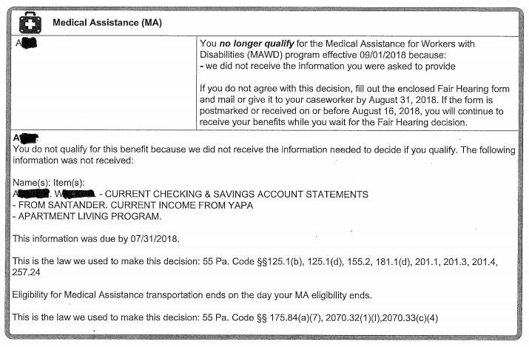

Slide 10
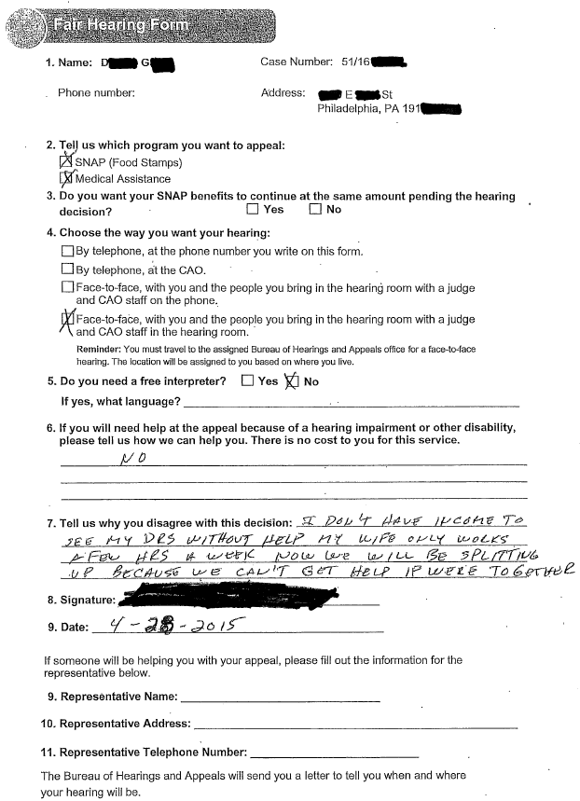

Slide 11
What is Medicaid?
aka Medical Assistance
joint federal-state health insurance program administered by the Pennsylvania’s Department of Human Services.
Covers:
hospital stays, doctor’s visits, tests, surgeries, home health care, nursing homes, prescription drugs, dental, vision, transportation.
Multiple ways to be eligible
MAGI MA, Healthy Horizon, MAWD, Waiver, etc

Slide 12
Medicaid Delivery

Slide 13
Managed Care Organizations
Almost all recipients receive their Medicaid physical health through a Managed Care Organization (MCO). Pennsylvania is divided into 5 zones.
MCO choices just changed in 2022 (Aetna out statewide)
MCOs in “Southeast” Region
includes Bucks, Chester, Delaware, Montgomery, Philadelphia
Geisinger*
Health Partners
Keystone First
UnitedHealthcare Community Plan
UPMC*
*new in 2022

Slide 14
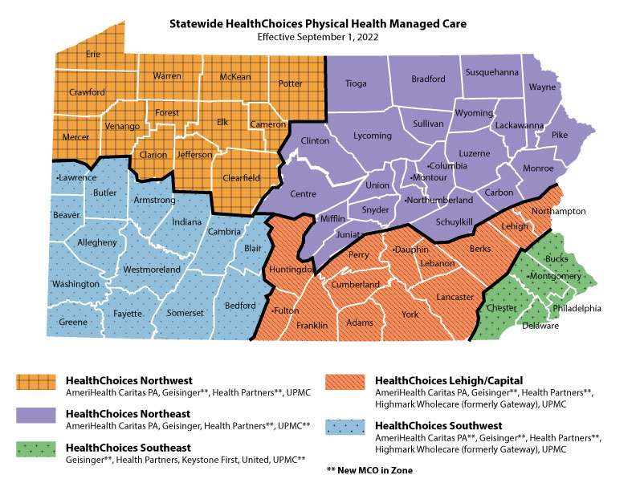

Slide 15
Behavioral Health
Provided by a single entity in each county.
PerformCare
Bedford, Cumberland, Dauphin, Franklin, Fulton, Lancaster, Lebanon, Perry, Somerset
Value Behavioral Health
Armstrong, Beaver, Butler, Crawford, Fayette, Greene, Indiana, Lawrence, Mercer, Washington, Westmoreland, Venango
Magellan Behavioral Health of Pennsylvania (MBH)
Bucks, Delaware, Lehigh, Montgomery, Northampton, Cambria
Community Behavioral Health (CBH) - Philadelphia
Community Care Behavioral Health Organization (CCBHO)
Adams, Allegheny, Bradford, Berks, Blair, Cameron, Carbon, Centre, Chester, Clarion, Clearfield, Clinton, Columbia, Elk, Erie, Forest, Huntingdon, Jefferson, Juniata, Lackawanna, Luzerne, Lycoming, McKean, Mifflin, Montour, Monroe, Northumberland, Pike, Potter, Schuylkill, Snyder, Sullivan, Susquehanna, Tioga, Union, Warren, Wayne, Wyoming, York

Slide 16
Who is not in an MCO
Initial few days/weeks of eligibility
5 year bar folks on GA-related MA
Recipients of EMA (non- US citizens who cannot get regular ongoing MA)
Above groups receive “Fee-for-Service” Medicaid (which is accessed via the ACCESS card)
MEDICARE recipients and HCBS/ Waiver recipients
But they are in Community HealthChoices MCOs (i.e., CHC MCOs)

Slide 17
Medicaid: MAGI MA a/k/a Expansion

Slide 18
Medicaid Expansion
As of January 1, 2015, Pennsylvania has an expanded Medicaid program
A Brief History
Before the expansion:
To be eligible, must be low income AND fit into a category
Categories included: over 65; disability; pregnant; child; or parent
We will return to this next session: “Traditional” Medicaid
After the expansion:
All adults between 18-64 are eligible, if low income (and meet other restrictions). No additional “category” required.
Low income = income less than 138% of the Federal Poverty Line (FPL)

Slide 19
Eligibility for Adults
Income less than 138% FPL
Age 19 though 64
Residency in Pennsylvania
Not eligible for Medicare (Part A or B)
U.S. Citizen
Some immigrants may qualify but rules are complicated
Note: No asset test

Slide 20
Income
What is 138% FPL?
Look at 2022 Benefit Amount and Income Levels (handout)
For an individual: $1,563 per month / $18,754 per year
(full time minimum wage worker earns $15,080 per year)
For a family of four: $3,191 per month / $38,295 per year
What income is counted?
MAGI: Modified Adjusted Gross Income
Basically:
if the income is taxable, it counts;
if it is not taxable, it does not count.
More Complex:
AGI + tax exempt interest + foreign income + Social Security Benefits (with exception of SSI)

Slide 21
2022 Income Limits

Slide 22
Income Eligibility for MAGI
Adults: 138%
Children 6-18: 138%
Children 1-5: 162%
Children 0-1: 220%
Pregnant: 220%

Slide 23
What Income Counts
Counted
Not Counted
Wages & tips
Unemployment Compensation
Social Security benefits
(Retirement, Survivors, and Disability)
Pensions
Dividends and interest
Alimony received
Rents & royalties
Veterans benefits
Workers’ compensation
TANF (Temporary Aid for Needy Families)
SSI (Supplemental Security Income)
Child support
Scholarship income
Student loan interest
Gifts and inheritances

Slide 24
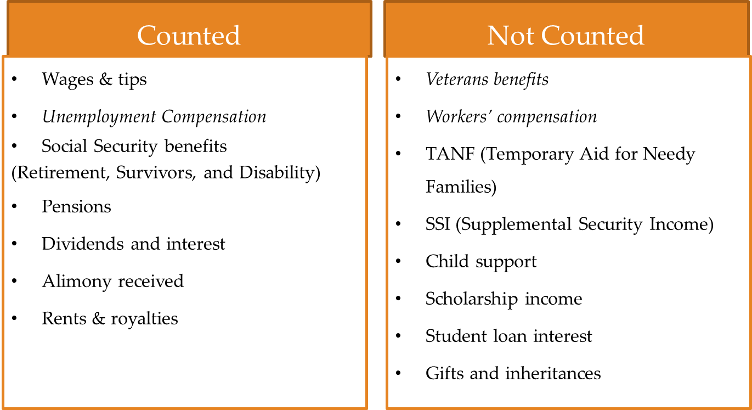
Hypo 1
Vanessa was laid off from her job and receives $1,000/month in unemployment compensation. She also receives $600/month in alimony. What is her MAGI income?
Because UC and alimony are taxable benefits, they both count in the MAGI income-eligibility analysis. Her countable income of $1,600 is over the income limit of $1,563 (138% FPL) in 2022 for a household of one in the MAGI Adult category

Slide 25
Hypo 2
Vanessa was hurt on the job and receives $1,000/month in workers’ compensation. She also receives $600/month in child support. What is her MAGI income?
Because worker’s comp and child support are not taxable benefits, neither counts in the MAGI income-eligibility analysis. With a countable income of $0, she is under the income limit of $1,563 (138% FPL) in 2022 for a household of one in the MAGI Adult category.

Slide 26
Household Size
Determining Household size can be complicated
It is done on a person by person basis. People living together may have different household sizes.
Generally, spouses/parents/children/siblings who all live together will count in each others households.

Slide 27
Traditional Medicaid

Slide 28
Traditional MA
MAGI/Expansion does not cover everyone:
People with income greater than 138%
People on Medicare
Most immigrants
Good News: the old “categorical” types of MA still exist – this is a great backup for those who do not qualify for expansion MA.

Slide 29
Traditional MA Eligibility
Must be a resident of Pennsylvania
Must fit into a category – e.g. 65+, disabled, etc.
Income Limits (different for each category)
Resource Limits for everyone except children & families with children (different for each category).
Must have the “right” immigration status or have an emergency medical condition

Slide 30
DETOUR: Disability Proof and MA Category
EMPLOYABILITY ASSESSMENT FORM
Can be used to prove disability for the GA-related, HH, or MAWD programs
Must include start and end dates
The Department of Public Welfare expects a good faith estimate, not clairvoyance.
MA coverage can only begin on the start date (which can be in the past).
MA will be cut off at end date unless a new form is submitted.

Slide 31
EAF – PA 1663

Slide 32
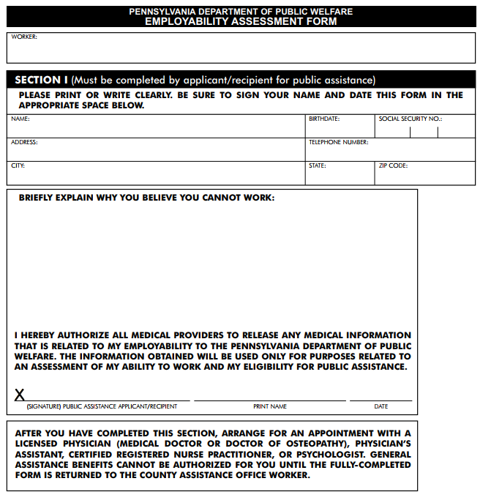
EAF – PA 1663 – Handout

Slide 33
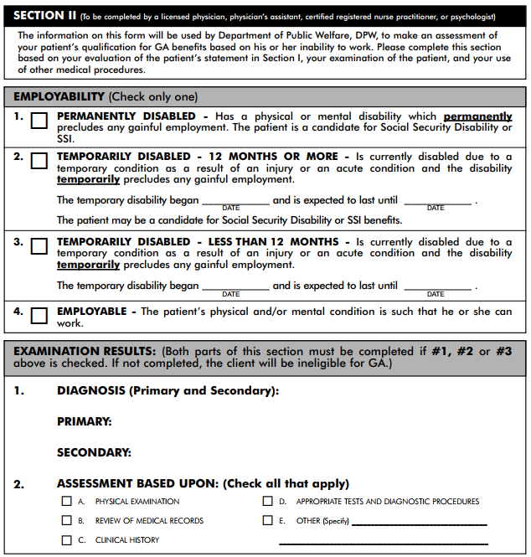

Slide 34
Healthy Horizons

Slide 35
Healthy Horizons People over 65 or with Disabilities
Disabled 12 months or more:
Employability Assessment Form
(EAF) (PA 1663)
Must check Box 1 or Box 2
Receipt of Social Security Disability benefits
OR
Over 65

Slide 36
Healthy Horizon Income Limits
Income Limit is 100% poverty for family size –
$1,133 for a household of 1 in 2022
Use SSI income counting rules
EARNED INCOME DISREGARDS
$20 (general exclusion for everyone)
$65
One half of remaining earned income

Slide 37
DETOUR: SSI Counting Rules
To determine Countable Income:
CI = UI + EI
Unearned income (UI)
$$$ - $20 general disregard
Earned income (EI)
$$$ - $65 (earned income disregard) divided by HALF

Slide 38
Question
Example:
Bob receives $500/month from his aunt and $465/month from his job.
What is his COUNTABLE income (using SSI counting rules)?
Unearned Income = ($500-$20) = $480
Earned Income = (($465-$65)/2) = $200
Countable Income = $680

Slide 39
SSI Income Counting
Learn this formula! Very important!
The Earned Income disregard is vital in providing coverage to people earning up to 500% FPL. (Spoiler: MAWD!)

Slide 40
Back to Healthy Horizons…
Income Limit is 100% poverty for family size –
$1,133 for a household of 1 in 2022
But really…up to 200% FPL if all income is earned

Slide 41
Healthy Horizons Resource Limit
$2,000 individual
$3,000 couple
This slide hasn’t changed since ________?.
1989!?!
NOTE: No Resource test for HH if there is a minor child in the house!

Slide 42
Questions
Can I get HH if I have other health insurance through my work?
Can I collect Unemployment Compensation and get HH?
Can I work full time and get HH?

Slide 43
Hypo
On April 1, 2022, Margaret comes to your office with a large hospital bill from January 2022. Margaret was hospitalized because of complications from her HIV. She missed a few weeks of work but will be going back soon. Margaret makes $3,000 per month gross. She has two children, age 4 and 10. She has very limited coverage through work for herself and her children.

Slide 44
Hypo
Roger was working until he was laid off. He immediately went on unemployment compensation. He receives $500/2 weeks.
Eligible?
Yes. Under expansion MA. Easily under 138%. Expansion MA is the default category.
What if Roger is 66?
Eligible?
Not for Expansion MA (too old). Now consider Healthy Horizons. He is likely eligible (but would need to know what other info?)

Slide 45
Example
What if Roger is 45 and earning $1,885/month while living with HIV?
Over income for Expansion/MAGI
(>138% FPIG)
But what is his countable income?
CI = EI + UI
No UI reported here
EI = $900 [( $1885 – 20 – 65) / 2]
CI ($900) is less than 100% FPL. Get EAF from doctor and document resources. Likely eligible for Healthy Horizons.

Slide 46
MAWD (Medical Assistance for Worker’s with Disabilities)

Slide 47
Highlighting MAWD
Very underused program – at least in Philadelphia
But maybe getting more well-known? Until recently Allegheny, Westmoreland, and Lancaster counties all had more than Philadelphia.
For clients under 65 with income too high for Healthy Horizons
People working despite serious medical conditions
People with disabilities whose spouses earn too much for them to get Healthy Horizons
Working and receiving compensation
Job can be small–one hour per week.
Receiving SSD, completed EAF or health sustaining meds form

Slide 48
Who should get MAWD?
Too “rich” for Healthy Horizons
Full time workers with significant health problems -- NEED TO SHOW DISABILITY
DISABLED individuals with incomes over 100% of poverty -- NEED TO GET A JOB
DISABLED individuals with spouses who work and are over income for HH

Slide 49
What is a Job for MAWD?
No specific number of hours required
No requirement that taxes be withheld
No specific hourly rate required (minimum wage is typical)
Self-employment forms/business plan rarely needed, but often improperly asked for

Slide 50
MAWD Income Limits
YOU WILL RARELY ENCOUNTER ANY CLIENT WHO IS OVER INCOME FOR MAWD
2022
250% FPL
Family of 1 $2,831
Family of 2 $3,815
Family of 3???
Don’t forget the EARNED INCOME DISREGARDS ($20; $65; one half the rest!)
The effective income limit for a single person who works despite his or her disability is OVER $65,000 per year!
After 1 year on continuous MAWD, income limit is 600% FPL – “Workers with Job Success” category

Slide 51
MAWD Resource Limit
$10,000
Recent change in law makes it so after 1 year on MAWD, a very very very select view (those with “workers with job success”, no longer have resource limit)

Slide 52
MAWD Costs
Unlike other categories o MA, people on MAWD must pay a monthly premium for their coverage.
The premium is 5% of Countable Income
Workers with Job Success pay 7.5%
Typical cost is between $50-100
Some plans on the Marketplace, with subsidies, could cost lest. However, those plans will usually have higher out of pocket costs in deductibles, co-pays, and co-insurance.

Slide 53
Proving Disability for MAWD
On Social Security Disability, or
EAF, or
Health Sustaining Medication Form (PA 1671)

Slide 54
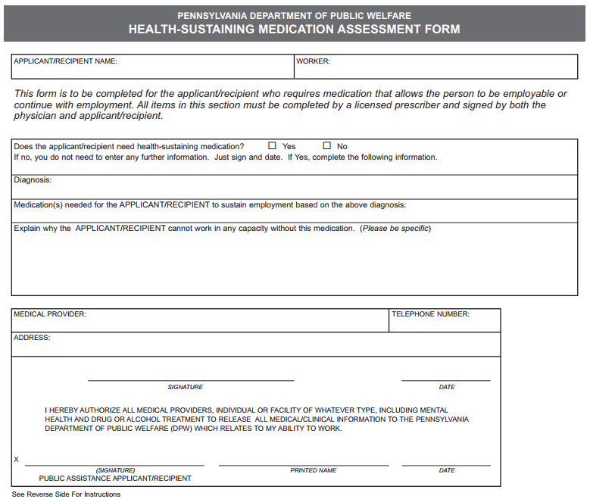
Health Sustaining Med Form

Slide 55
Hypo
Anne (age 49) states on her application that she will claim her daughter, Susan, and her son, Ian, on her tax return. Anne is HIV positive and has a job that pays her $3,065/month. She also receives $320/month in child support for Ian.
MAGI/Expansion?
MAWD?

Slide 56
Why is this hypo in wrong section?
Earned Income: $3,065 – 65 then /2 = $1,500
Unearned income $320 – 20 = $300
Total Countable: $1,800
Healthy Horizon household of 3 limit: $1,919 in 2022

Slide 57
Hypo Redo
Anne (age 49) states on her application that she will claim her daughter, Susan, and her son, Ian, on her tax return. Anne is HIV positive and has a job that pays her $5,085/month. She also receives $300/month in child support for Ian.
$5,085 - $20 - $65+ $5,000
$5,000/2 = $2,500

Slide 58
Waiver
The name waiver comes from the fact that the federal government "waives" Medical Assistance/Medicaid rules for institutional care in order for Pennsylvania to use the same funds to provide supports and services for people in their homes.
In Pennsylvania, the DHS’s Office of Long Term Living administers the waiver program

Slide 59
AIDS Waiver

Slide 60
Community Health Choices Wavier via Office of Long Term Living (OLTL)
Eligibility:
Over 21
Meet the CHC waiver functional eligibility requirement
Nursing Facility Clinically Eligible
Meet the waiver financial eligibility requirements

Slide 61
Waiver Income & Resource Limits
Income eligibility not based on FPL but rather the Federal Benefit Rate (that is, the SSI amount)
Only the income of the person applying is considered
But resources of spouse are considered
3 x SSI FBR
2022: $2,523/month
Resource: $8,000 but special rules for spousal impoverishment

Slide 62
Waiver Application
Cannot apply at CAO.
Must apply through the Independent Enrollment Broker (previously known as Maximus):
877.550.4227
https://www.paieb.com/
Application steps:
Contact IEB
Physician Certification sent to doctor
1st in person visit – The Independent Enrollment Broker – assists with financial application
2nd in person visit – Philadelphia Corporation of Aging (or other local Agency on Aging) – Functional Eligibility Determination
IEB reviews functional eligibility
If Physician certification and Functional Eligiblity Determination disagree, then OLTL reviews
CAO (in Philadelphia it’s special office called OLTL) reviews financial eligibility.

Slide 63
Waiver – Personal Assistance Service Reductions
Starting in 2018, the waiver program went from being run by the state to being administered by
Community HealthChoices Managed Care Organizations
At first, these CHC MCOs were not permitted to cut people’s PAS hours. The restriction has been lifted and they are slashing hours
There are three CHC MCOs: AmeriHealth/Keystone, PA Health & Wellness, and UPMC.

Slide 64
Immigrant MA Options

Slide 65
State-funded: GA-Related MA (Coverage of Last Resort)
Income Limits*
1 | $ 205
2 | $ 316
3 | $ 403
4 | $ 497
5 | $ 589
6 | $ 603
Most people who received this “traditional” coverage in the past are now receiving expansion coverage.
Almost everyone in this category now is an immigrant that does not qualify for federally-funded Medicaid.
* $250 resource limit for single adults; $1,000 for everyone else.

Slide 66
Emergency Medical Assistance
For people whose immigration status prohibits them from Medical Assistance.
Must meet financial qualifications of one of the categories to get MA.
Must have an “Emergency” medical condition defined as:
A medical condition, including emergency labor and delivery, manifesting itself by acute symptoms of sufficient severity including severe pain that would result in one of the following:
1. placing the patient’s health in serious jeopardy (or with respect to a pregnant woman, the health of the woman or her unborn child);
2. serious impairment to bodily functions;
3. serious dysfunction of a bodily organ or part.

Slide 67
Comparing Traditional MA categories for people with disabilities
GA-related: very low income/resource limits, comes with hospital deductible and higher co-pays
Healthy Horizons: higher income/resource limits, requires doctor to complete 12 month EAF, best package of benefits
MAWD: high income/resource limits, need earnings, flexible disability proof, premium payments, best package of benefits
Waiver: high income/resource limits, need nursing home level of care, best package of benefits

Slide 68
Special Pharmaceutical Benefits Program (SPBP)

Slide 69
SPBP
SPBP is Pennsylvania’s version of the AIDS Drug Assistance Program
Run out of the Department of Health, not DHS
Covers:
Prescription drugs – not just HIV prescriptions but a wide variety
Some lab work
SPBP HIV/AIDS is the payer of last resort and third party resources must be used before payment is made by the program.

Slide 70
SPBP Eligibility
Applicants must be:
a resident of Pennsylvania,
have a gross annual income of less than or equal to 500% of the Federal Poverty Level (FPL), and
have a diagnosis of HIV/AIDS to qualify for the program.
No resource test

Slide 71
SPBP & other Insurance
SPBP works well with other insurance.
It’s possible for a person to have:
Private insurance and SPBP
Medicare and SPBP
SPBP partners with specific Part D plans (pays all premiums and copays/coinsurance); it also will pay the premium for some Medicare Advantage plans (and any copays/coinsruance for prescriptions).
Medicare, Medicaid, and SPBP
Medicaid does not cover prescription drugs when paired with Medicare, which is where SPBP can help.

Slide 72
SPBP Application
Download application at https://www.health.pa.gov/topics/Documents/Programs/HIV/Special%20Pharmaceutical%20Benefits%20Program%20Full%20Application%20-%20Effective%2004-17-18.pdf(or search for “SPBP Application Pennsylvania”)
Fill it out – a licensed clinician (MD, PA, CRNP) must sign.
Mail, fax, or email it in (info on application)
Do NOT send it to the CAO or DHS…it’s not their program

